Slide 1
Different community finding algorithms on classic generated model and real networks
Generate a test bed
Evaluate different algorithms on the test bed
Observe how the algorithms work on the test bed and on real networks

Slide 2
Classical generated model
4 communities (32 nodes each) with random links
Average connections within-community: z_in
Average connections out-community: z_out
z_in + z_out = ⟨k⟩ = 16
==>
When z_out is close to 0, it is easy to identify communities
When z_out is close to 8, the graph becomes homogeneous
When z_out is close to 16, nodes tend to avoid their own community

Slide 3
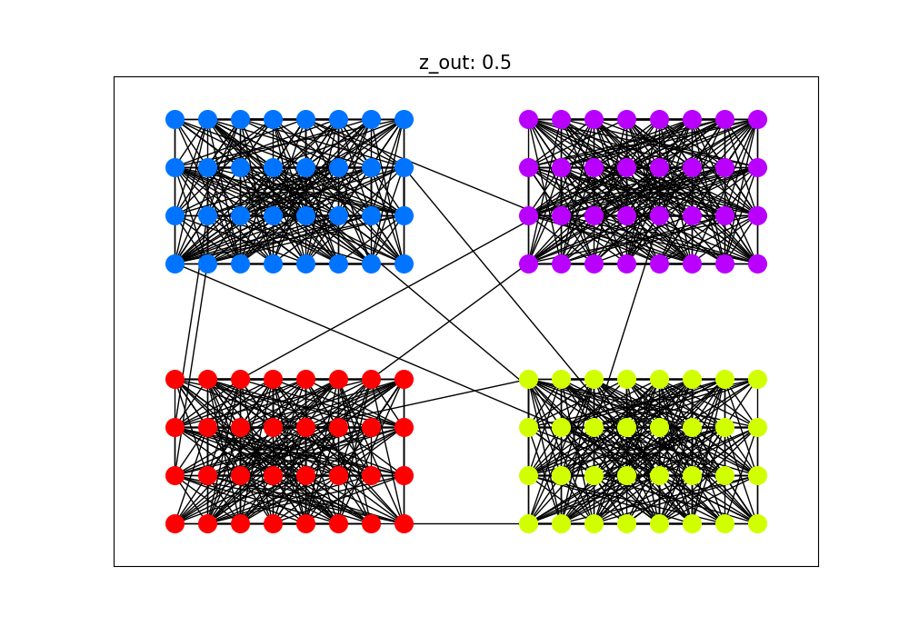
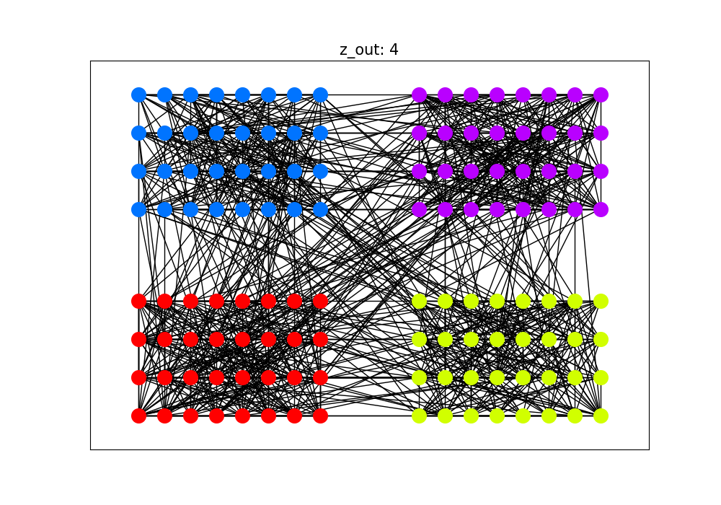
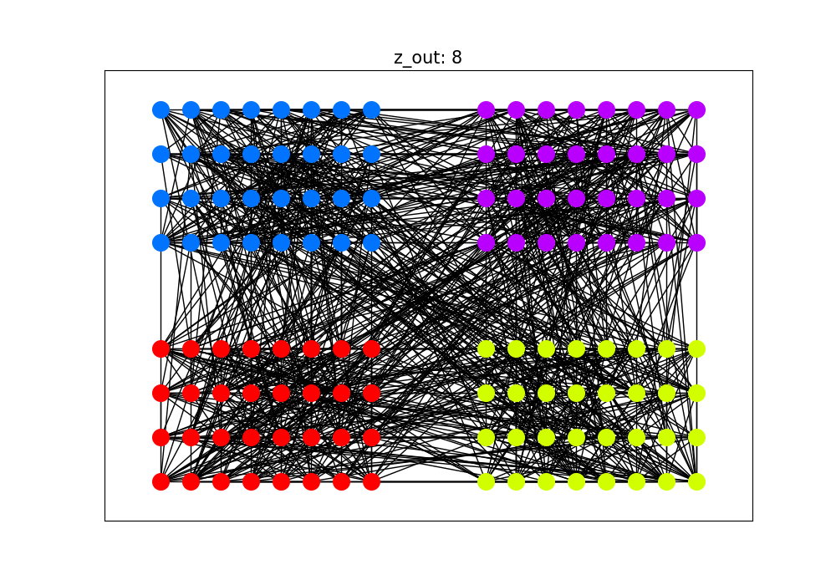
Example of generated model with different z_out
We will generate graph with z_out at:
0.5, 4, 8, 12, 15.5

Slide 4
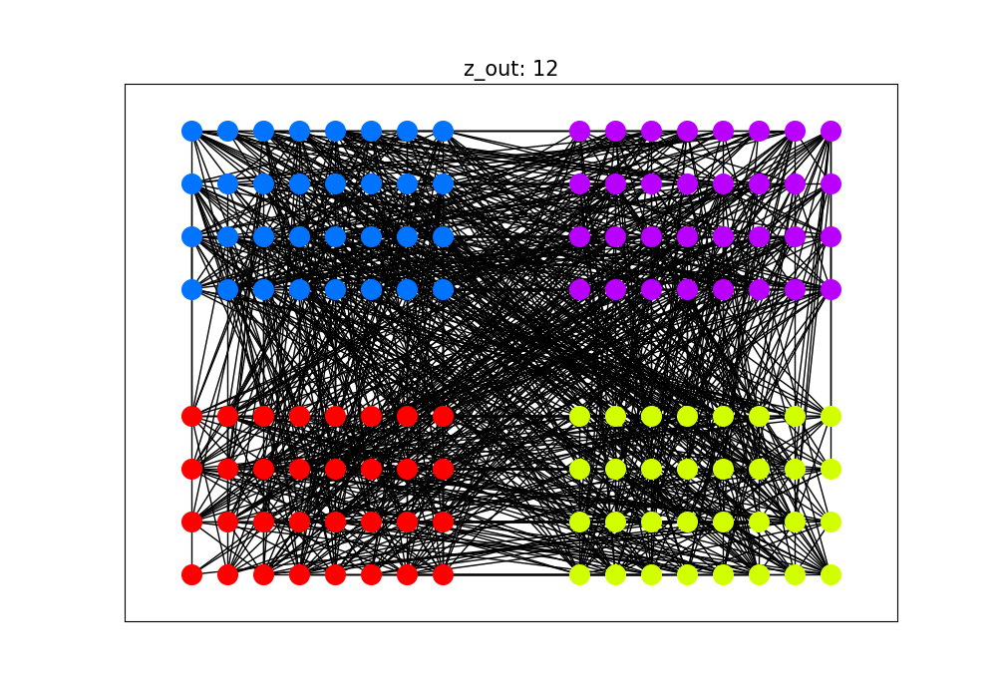
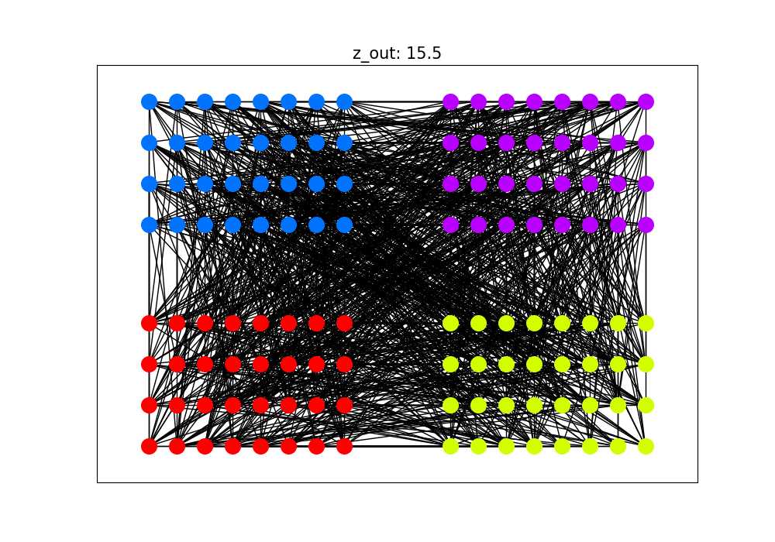

Slide 5
Different community finding algorithms
Algorithms:
Louvain
Surprises community
Leiden
Walktrap
To evaluate the algorithms, we check the similarity between four ground truth groups and the found groups.
We will observe for different z_out values:
AMI (Adjusted Mutual Information): a metric to compare similarity of two clusterings for a dataset. The higher AMI, the better accuracy algorithm has.
Number of communities found by algorithms
The data will be simulated 100 times to calculated for randomness.
References:
https://en.wikipedia.org/wiki/Louvain_method
https://cdlib.readthedocs.io/en/latest/reference/cd_algorithms/algs/cdlib.algorithms.surprise_communities.html
https://cdlib.readthedocs.io/en/latest/reference/cd_algorithms/algs/cdlib.algorithms.leiden.html
https://cdlib.readthedocs.io/en/latest/reference/cd_algorithms/algs/cdlib.algorithms.walktrap.html
https://en.wikipedia.org/wiki/Adjusted_mutual_information

Slide 6
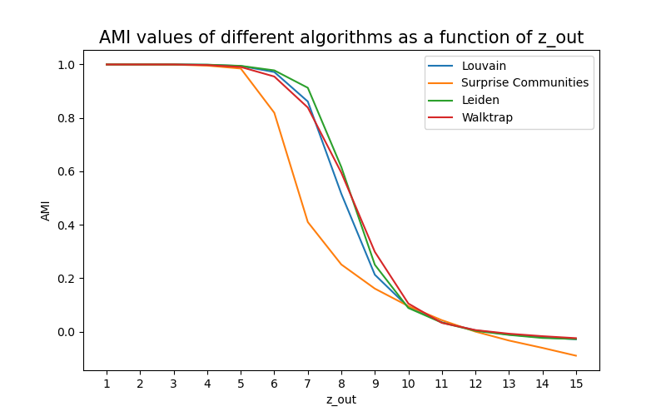
Different community finding algorithms

Slide 7
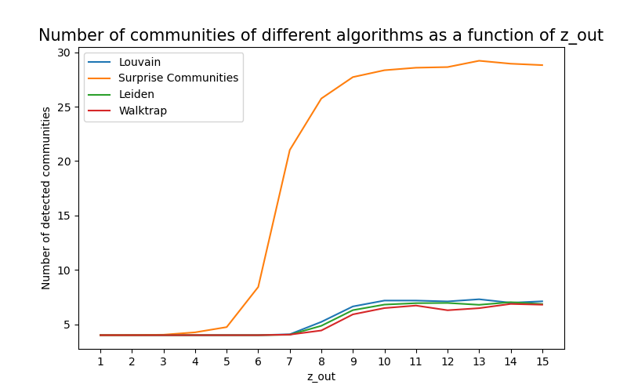
Different community finding algorithms

Slide 8
Observe algorithms on generated networks
The algorithms performances start to degenerate at z_out = 7, thus we will generate graph with z_out at:
0.5, 4, 7, 8, 12, 15.5
Then, we will observe:
The number of communities found
AMI value
The graph of found communities

Slide 9
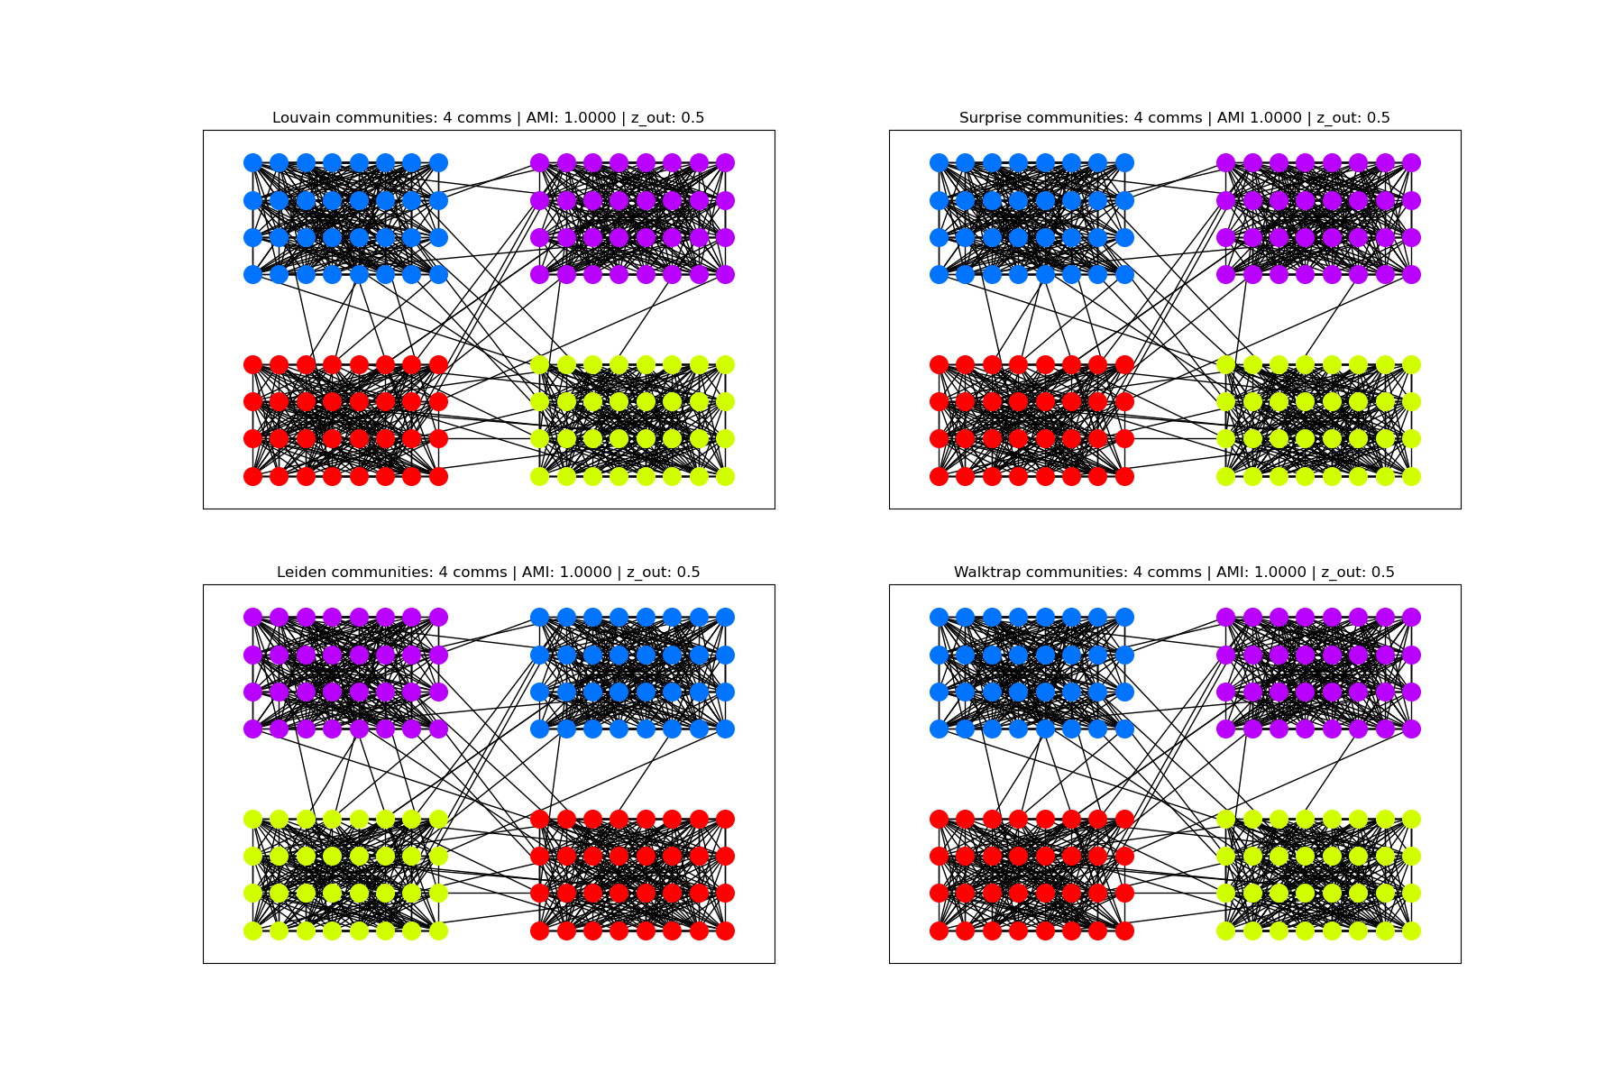

Slide 10
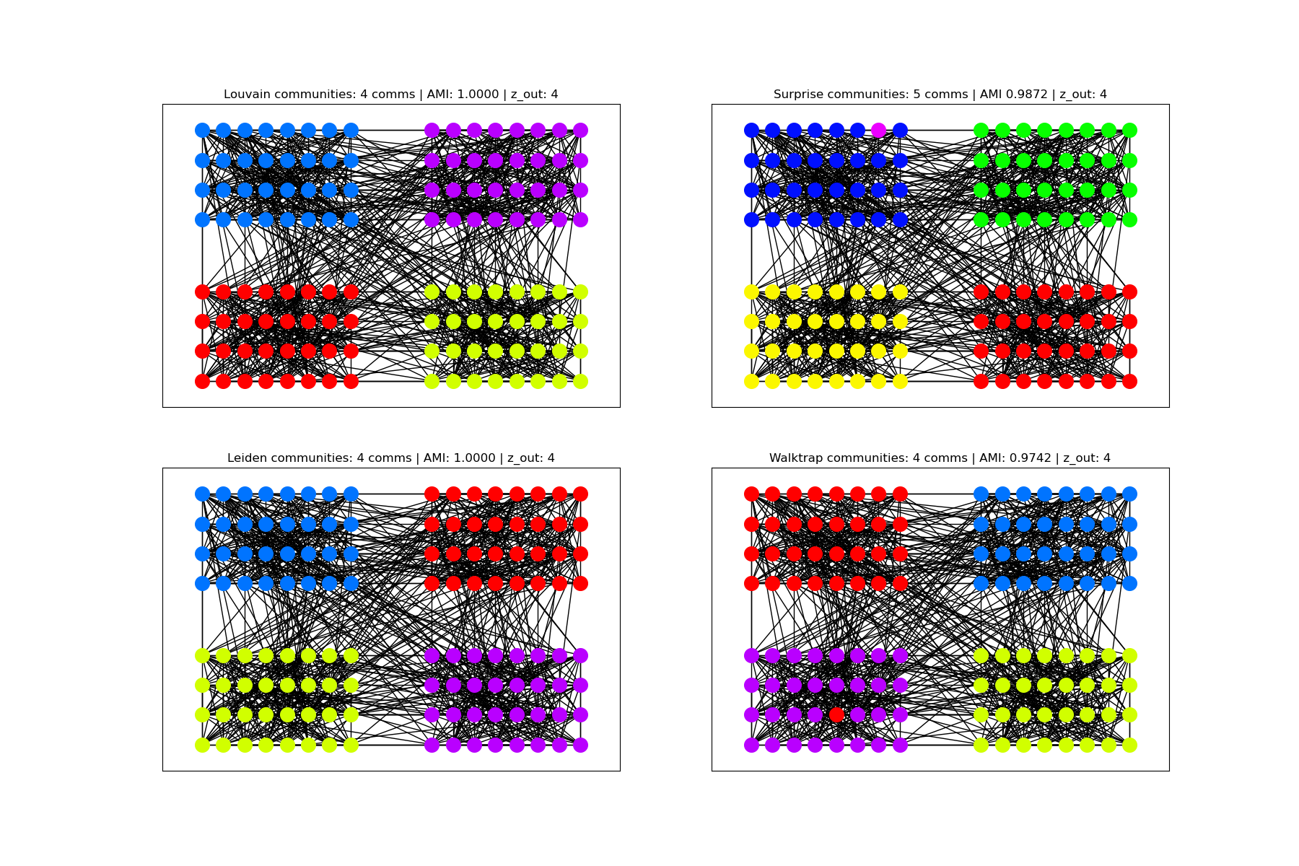

Slide 11
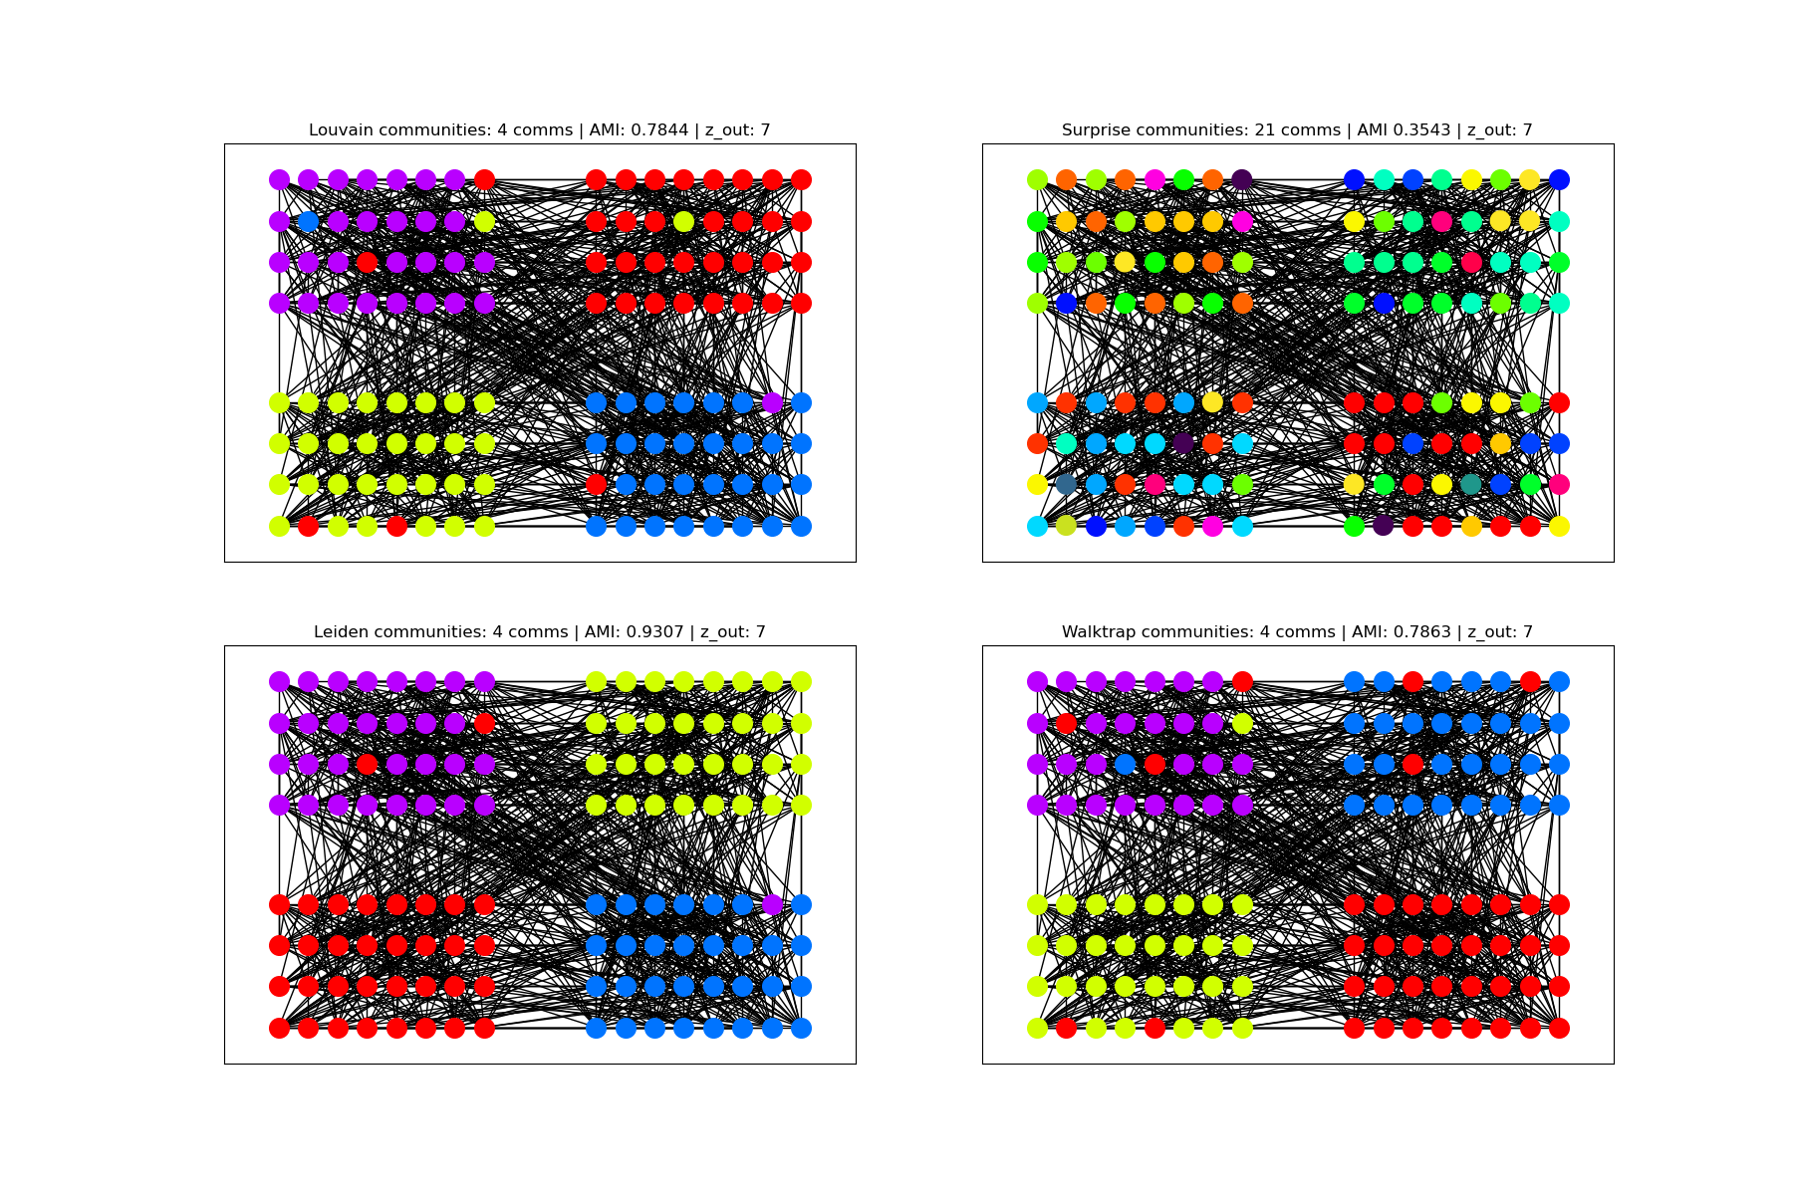

Slide 12
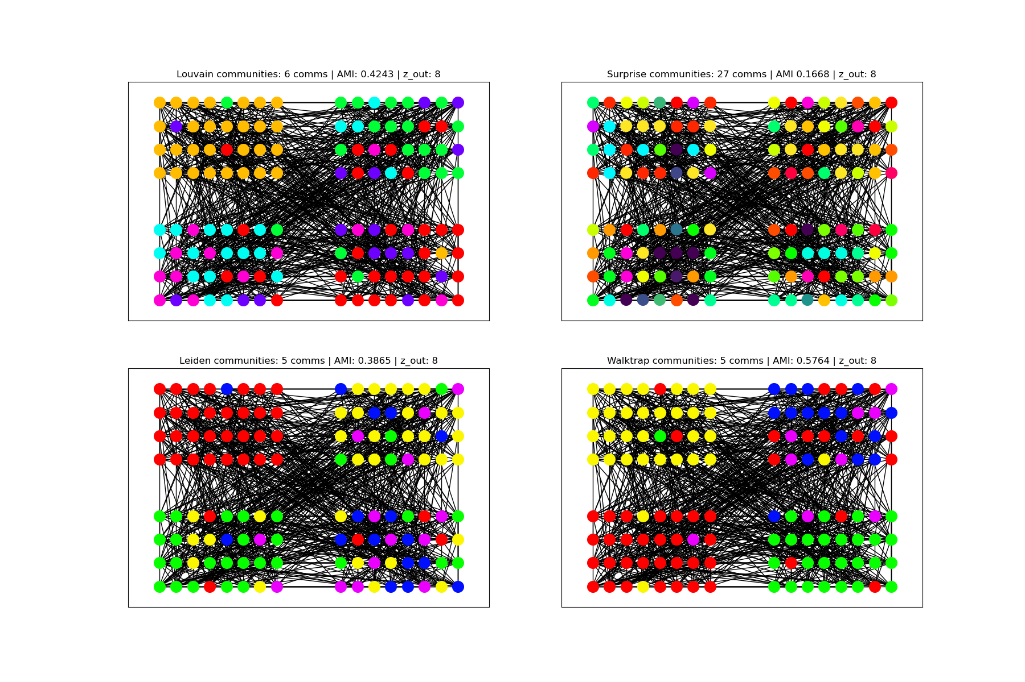

Slide 13
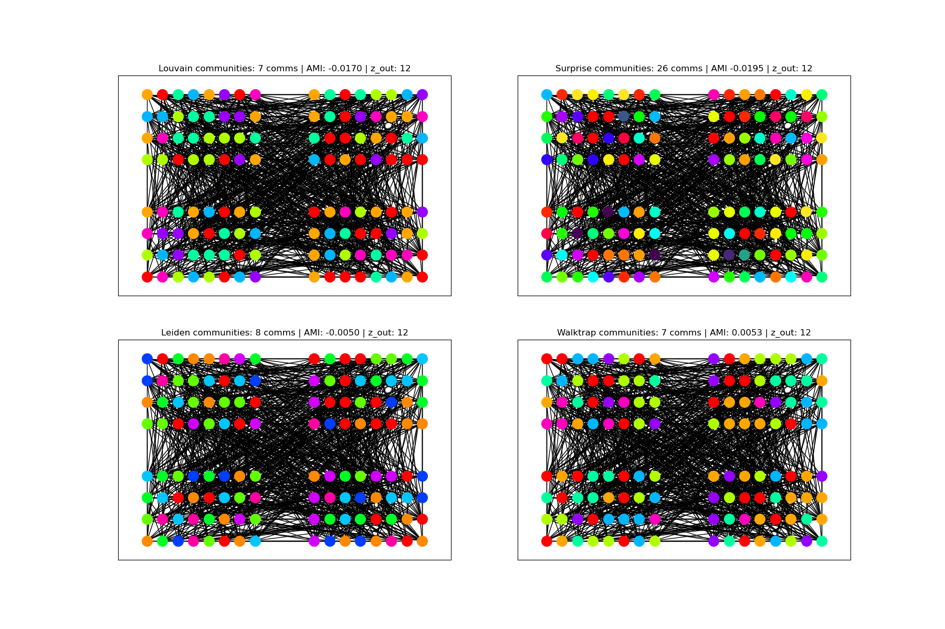

Slide 14
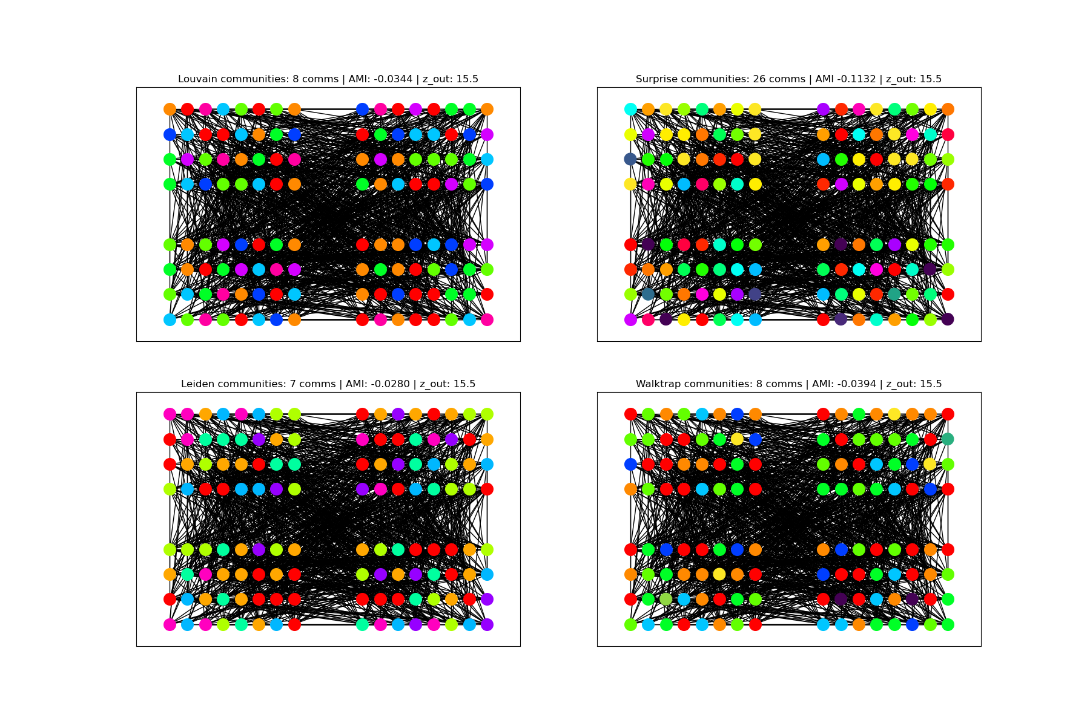

Slide 15
Observe algorithms on real networks
The Zachary’s Karate Club network:
34 nodes
78 edges
2 ground truth communities
The email-Eu-core network:
1005 nodes
25571 edges
42 ground truth communities
References:
https://networkx.org/documentation/stable/reference/generated/networkx.generators.social.karate_club_graph.html#networkx.generators.social.karate_club_graph
https://snap.stanford.edu/data/email-Eu-core.html

Slide 16
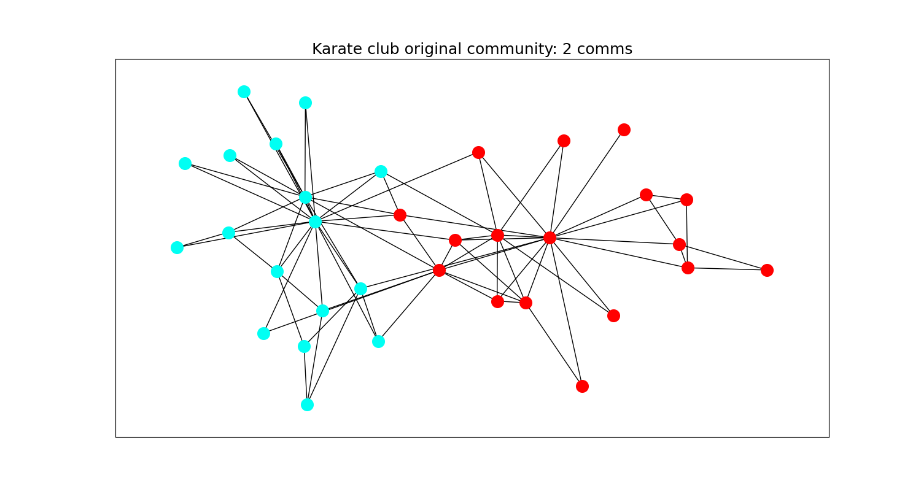

Slide 17
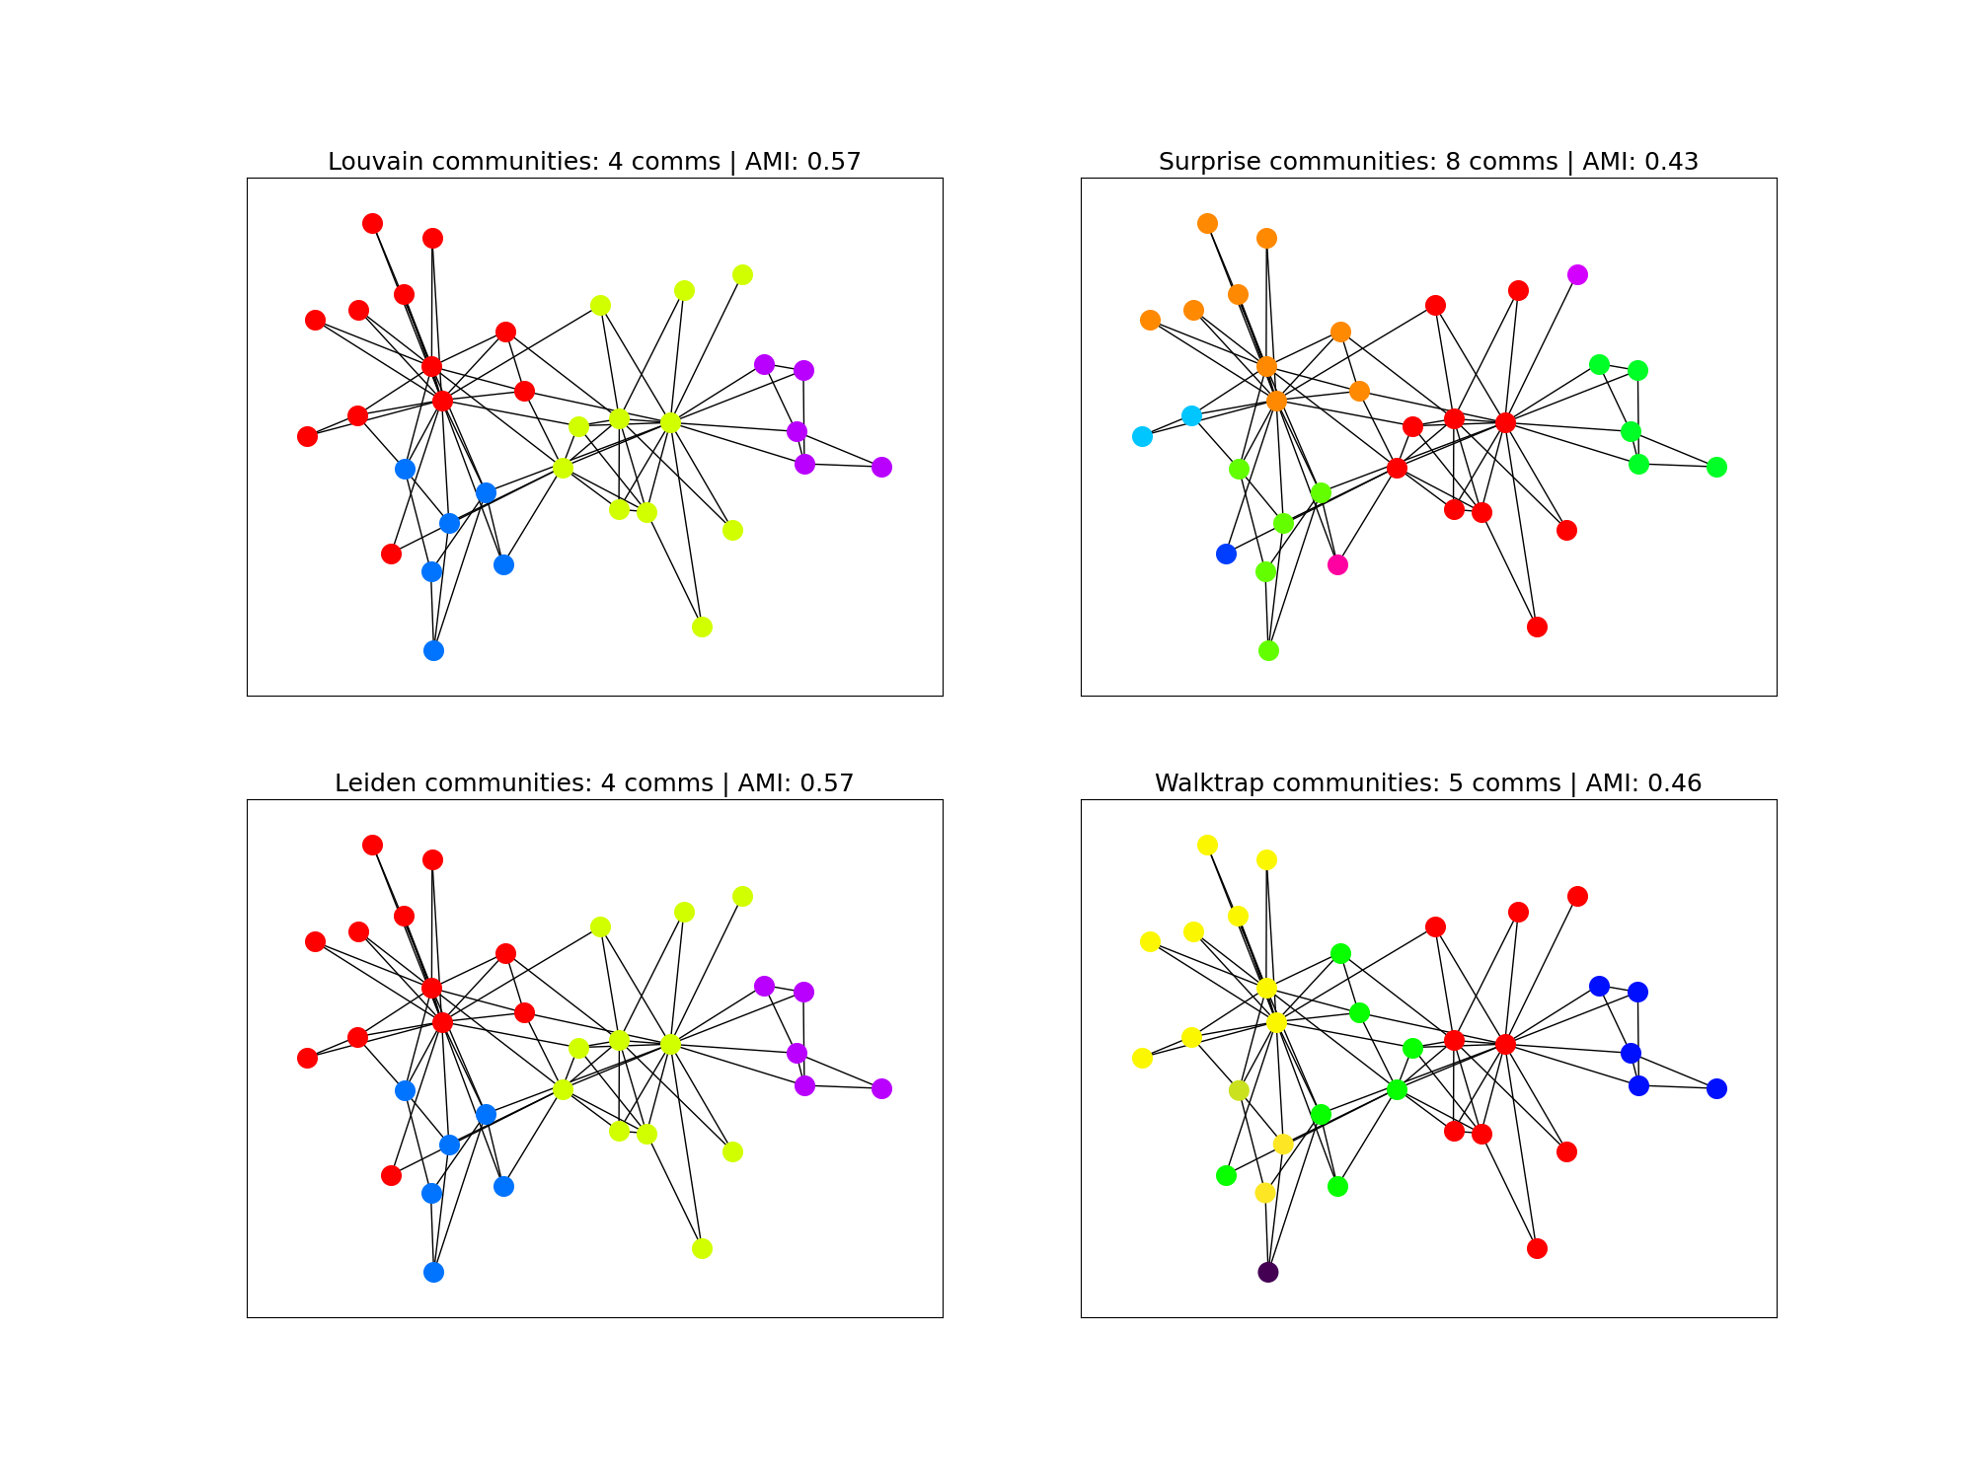

Slide 18
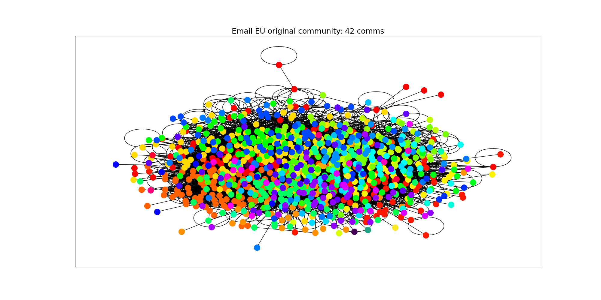

Slide 19
